Slide 1
RAD Fair Housing, Civil Rights and Relocation Notice:
Live Q&A
January 11, 2017

Slide 2
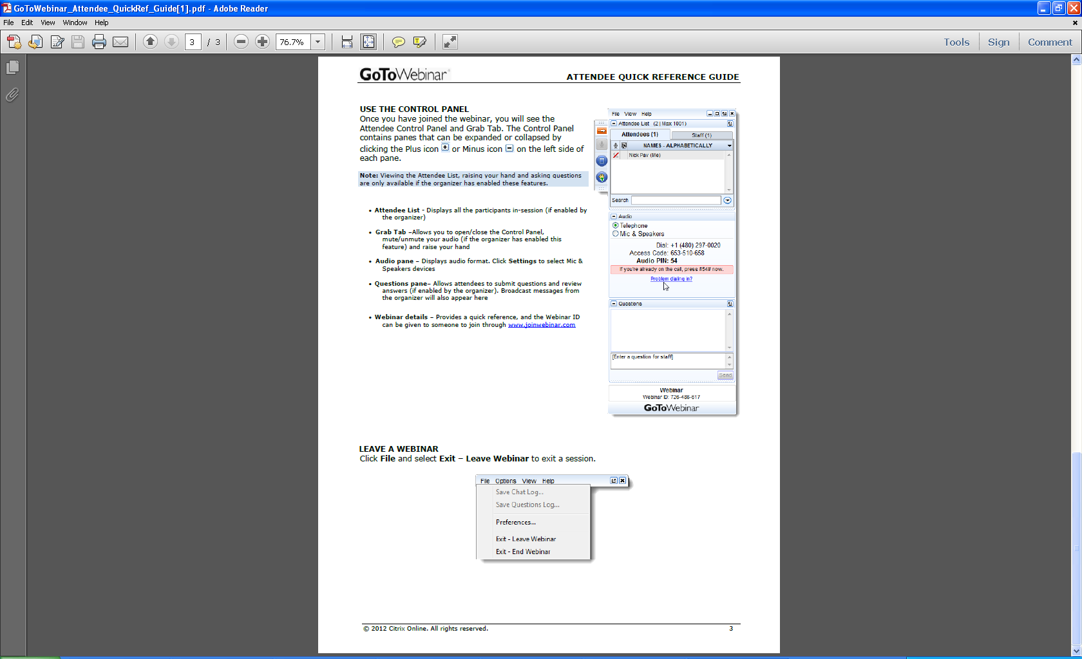
Welcome
Ask questions! Here’s how:
  “Raise your hand” by clicking on the
  hand icon and the presenter will
  un-mute your line so you can ask
  your question live
  Note: To do this, you MUST call the dial-in number shown on your attendee control panel and input the audio PIN shown, which is unique to each attendee
  Send in questions via the “Question” feature

